Slide 1
Futsal MS(Ground Booking)
00172895-Uttam Tamang

Slide 2
Introduction
Futsal Management System
Focused on Booking Process
Additional Admin facilities(To the extend)
User Friendly Interface
Online Booking system and Automatic record keeping system over paper based and visiting/phone process.

Slide 3
Background
Traditional way of booking system
Phone contact based
Self visit
Problem that took place
Availability
Reliability
Time
Project Should Support
follows new trend for sport lover (Web Based)
Any age ( Youngster, Working people)
Sound and Eco friendly
Safe and security
Extra facilities

Slide 4
Problem Statement
Time Consuming for both(Customer and Futsal)
Extra Human Resource
Un-Reliable
Availability issue
Marketing/Expanding issues

Slide 5
Aim and Objectives
Aims
Promoting Sport in social communities and Healthy Lifestyle
Fully automation system for booking and record keeping system over Manual.
Reliable and Secure System
Objectives
Reservation system will be made possible with online system.
User Friendly UI
Lower cost with potential facilities

Slide 6
Scope and Limitations
Scope
Make Online System
Secure and Reliable System
Limitation
Lacks in Online Payment system
Projects lacks upon Accessibility function
Rewards tracking per milestone for User.

Slide 7
Features
Authentication via Login/Registration
Profile Edit/Update
Ground Booking as per availability
Cancel their Bookings
Calculation Collections

Slide 8
Design Patterns
MVC- Model View Controller
Model
Central part and UI Independent.
View
Basically, view handles UI design of an application
Controller
It accepts user inputs and translate it as command for Model or View.

Slide 9
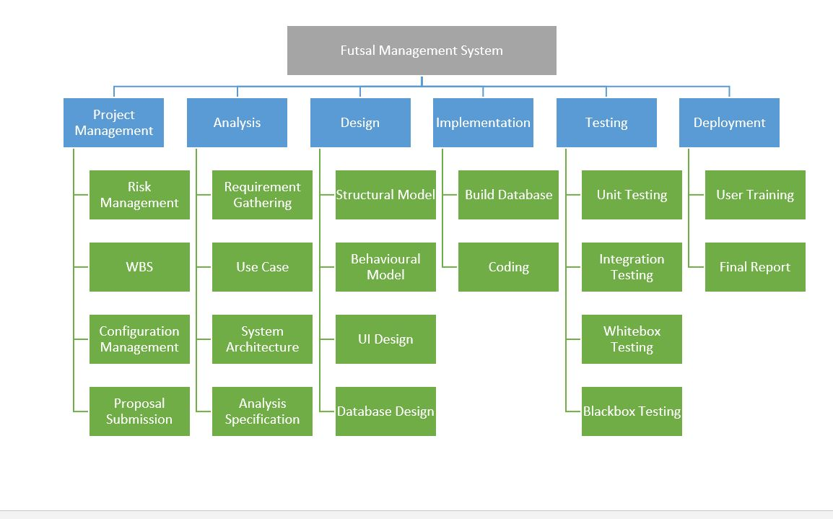
Work Breakdown Structure

Slide 10
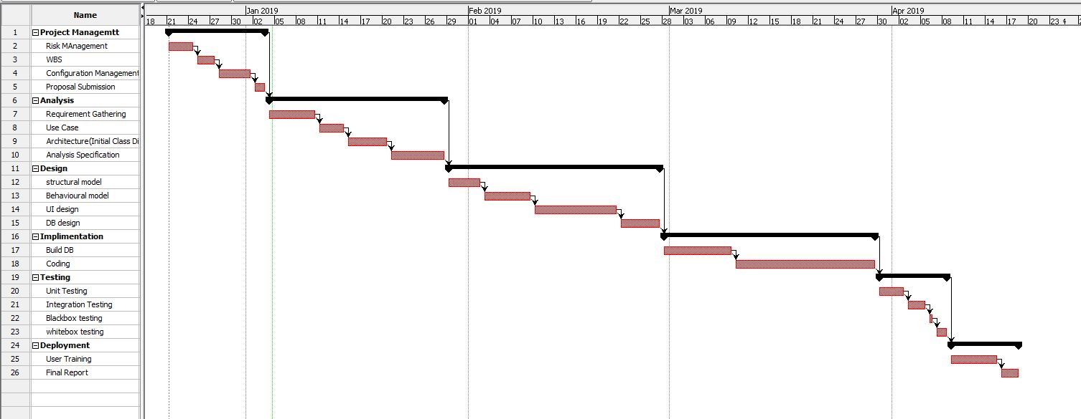
Gantt Chart-1

Slide 11
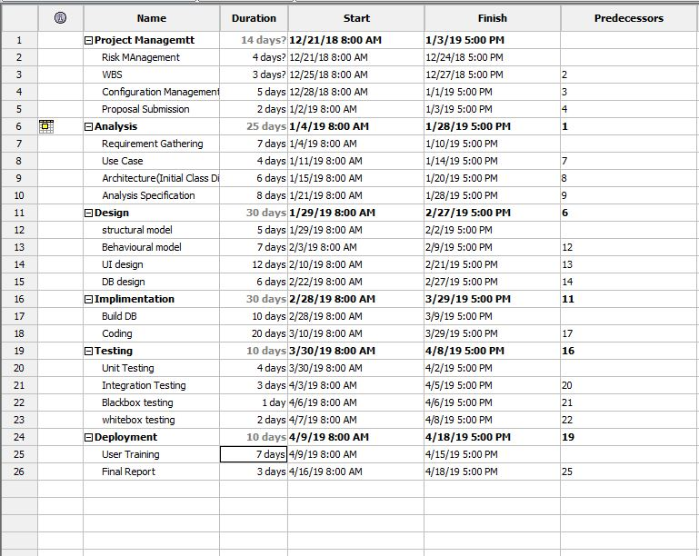
Gantt Chart-2

Slide 12
Development Methodology
Waterfall Model
Requirement Analysis
Design
Implementation
Testing
Installation
Maintenance

Slide 13
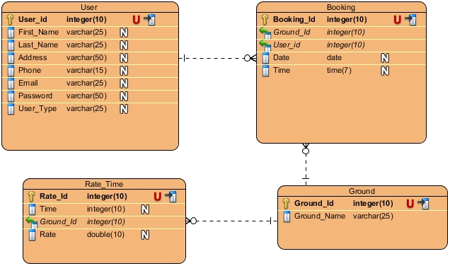
ER-Diagram

Slide 14
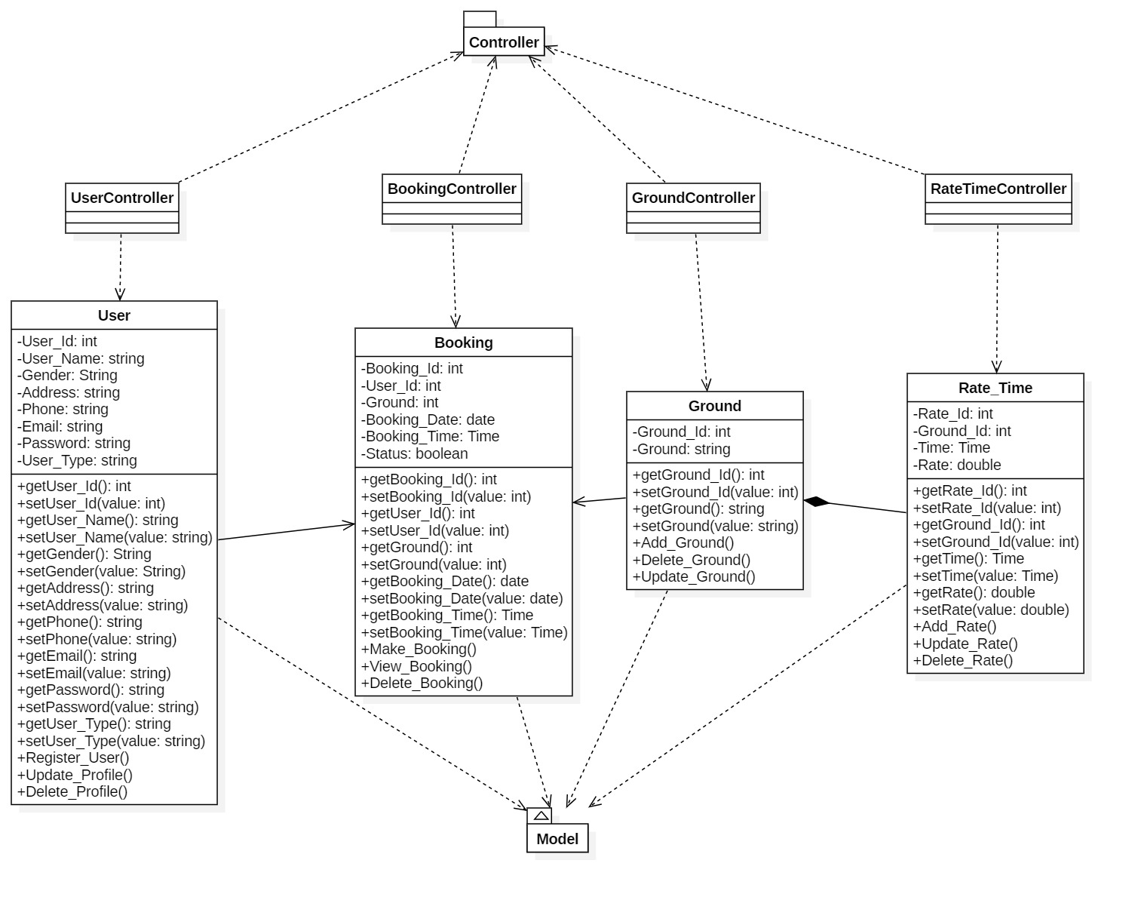
Static System Architecture – Class Diagram

Slide 15
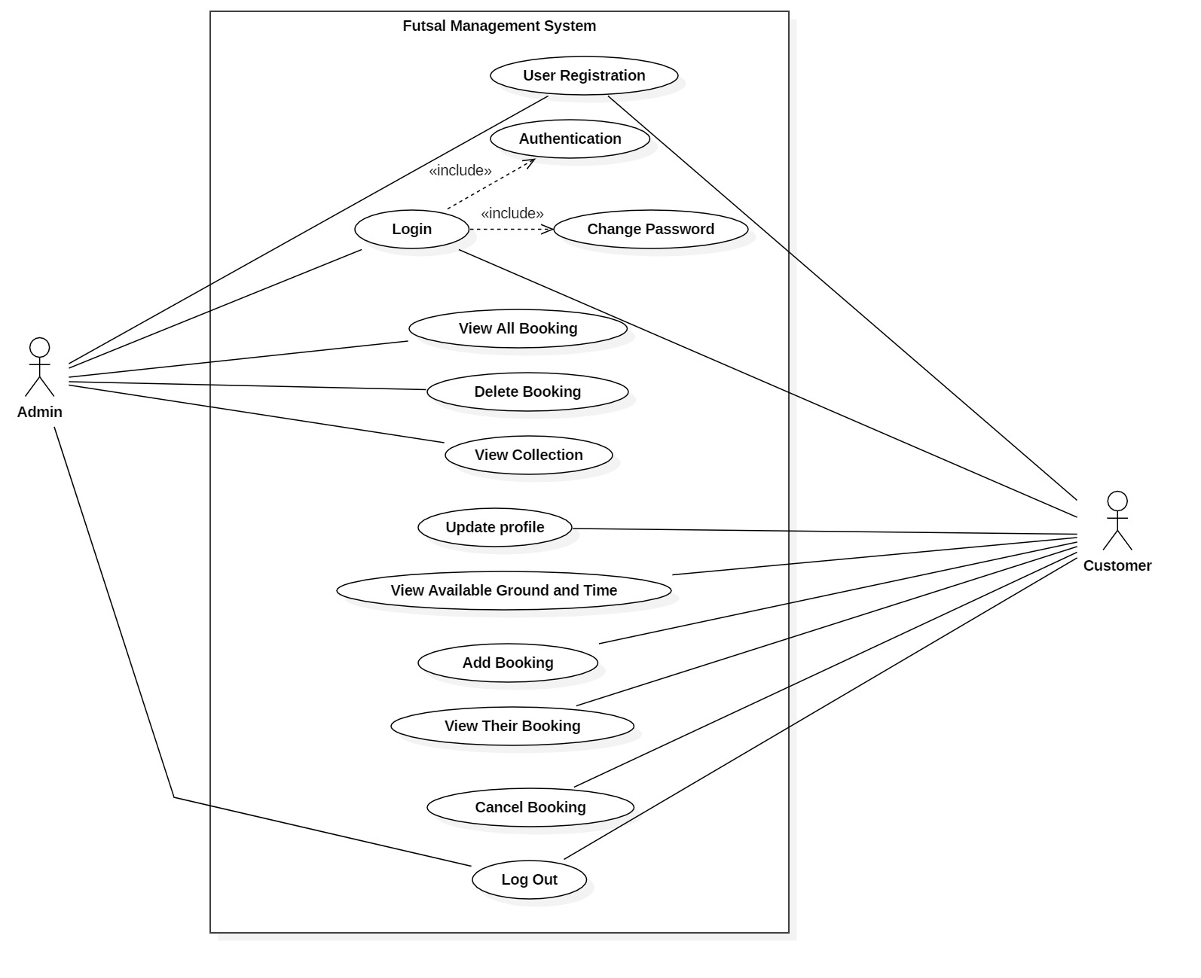
Use Case Diagram

Slide 16
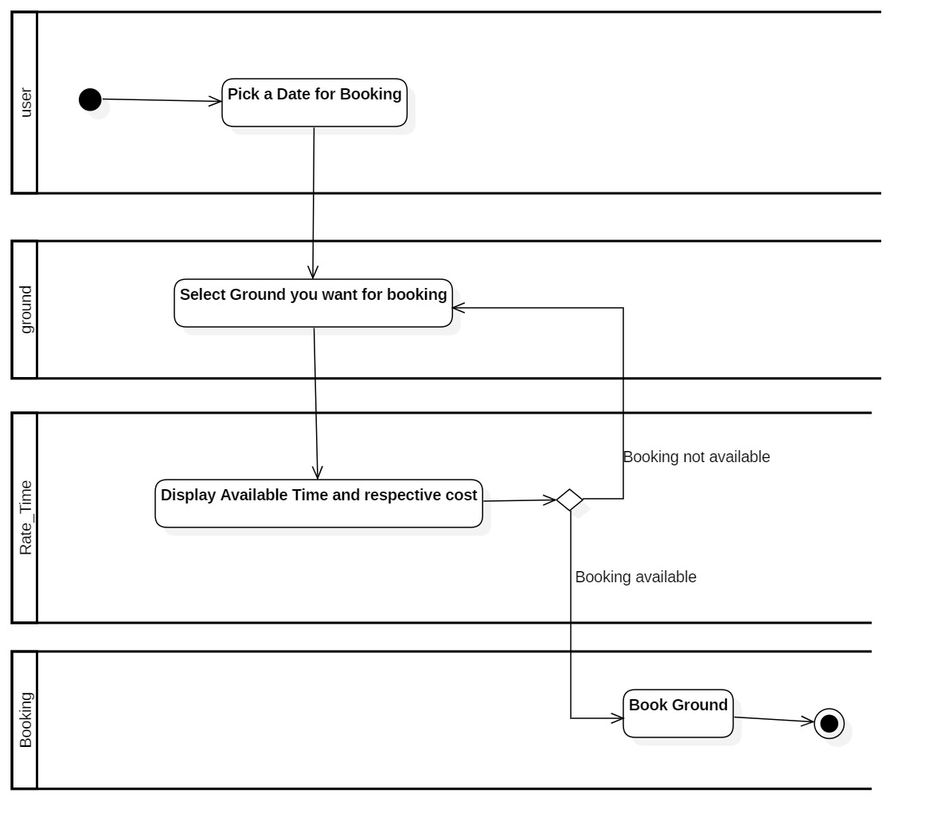
Activity Diagram -1 (Available Timeslot for booking)

Slide 17
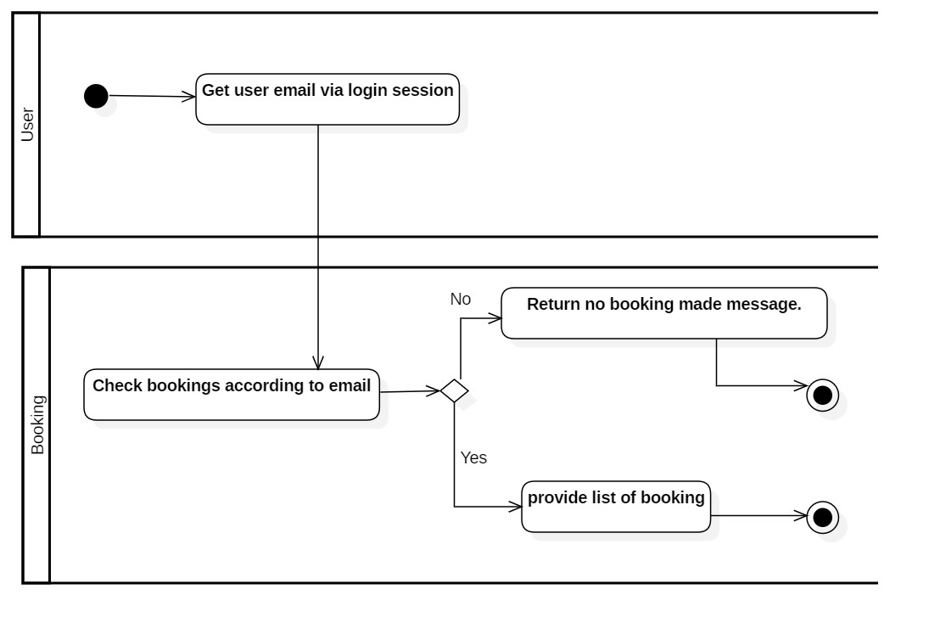
Activity Diagram-2 (View Booking Detail)

Slide 18
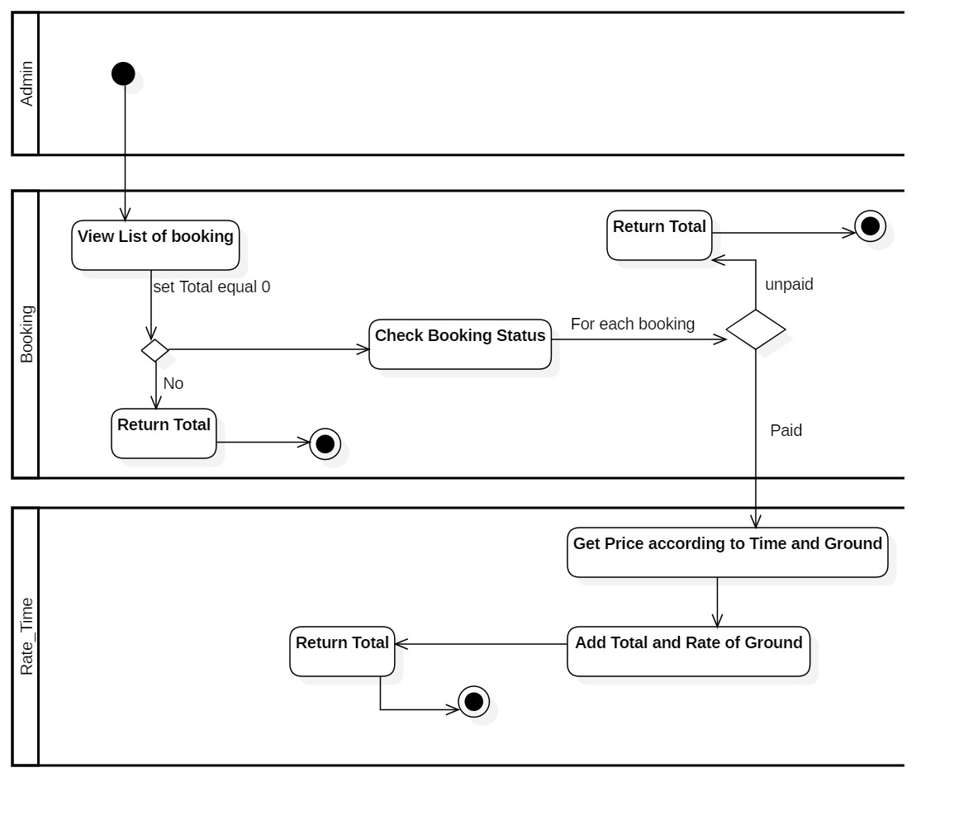
Activity Diagram-3 (Calculating Collection)

Slide 19
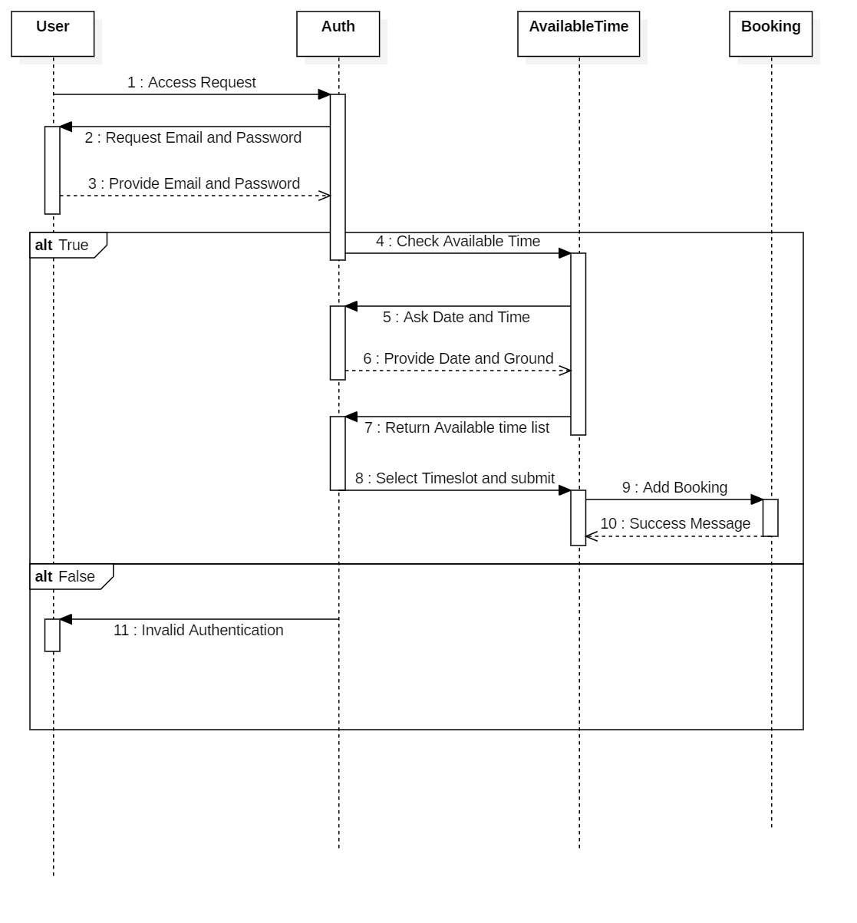
Sequence Diagram 1

Slide 20
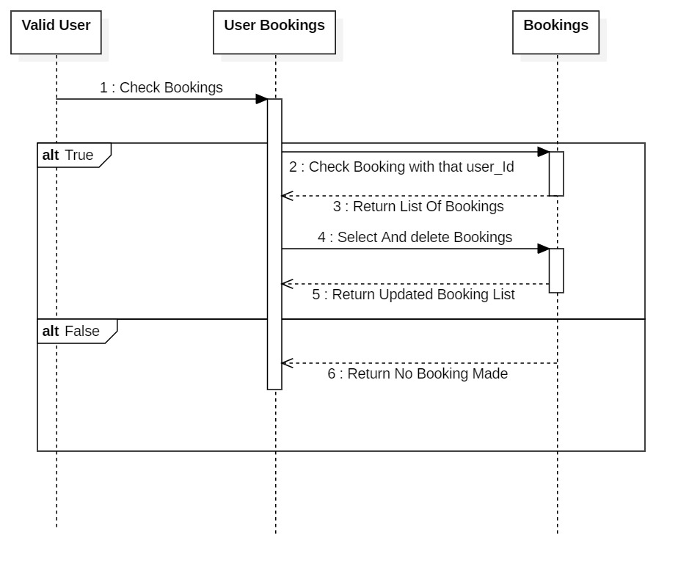
Sequence Diagram 1

Slide 21
User Interface
Typically 3 pages
Home page of futsal
Admin page
Customer/Client page

Slide 22
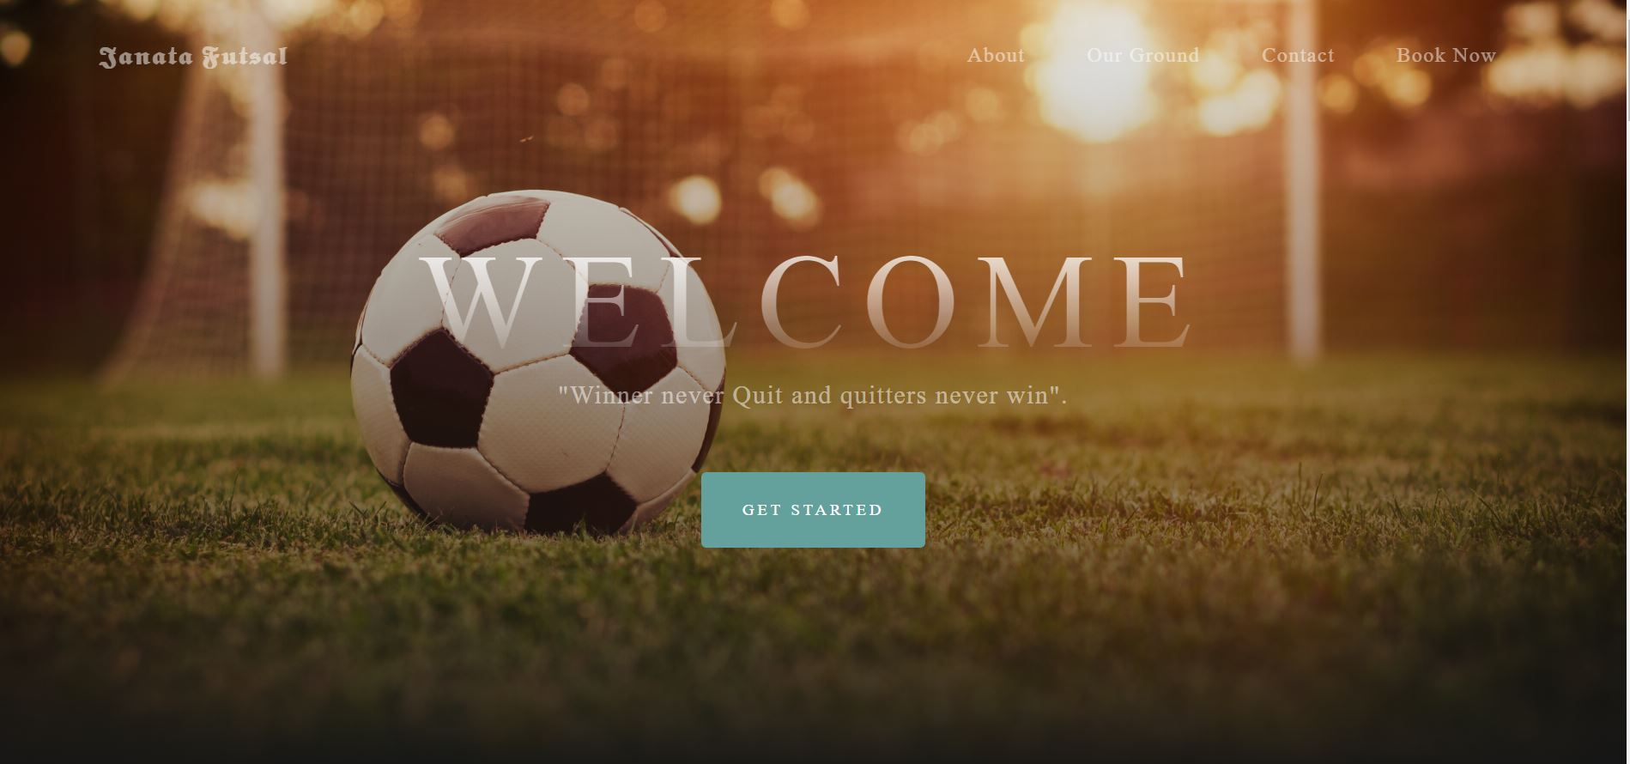
Home Page

Slide 23
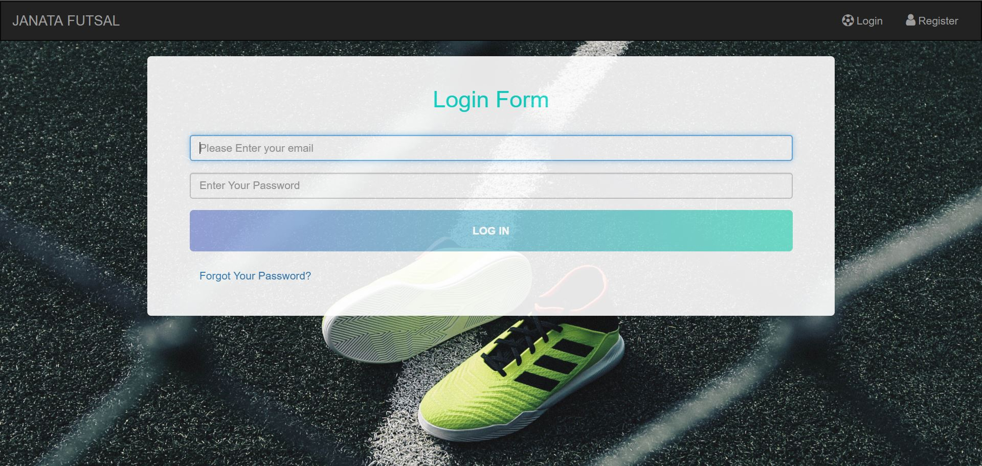
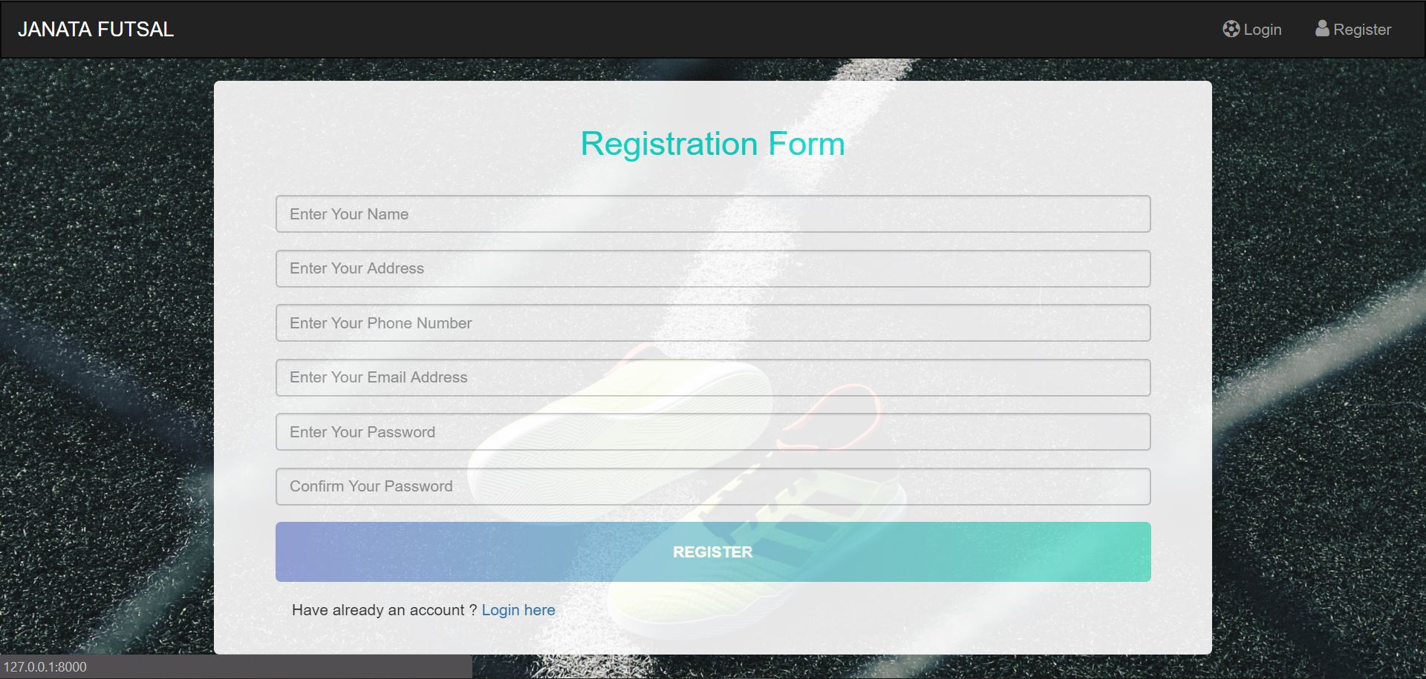
Login and Registration

Slide 24
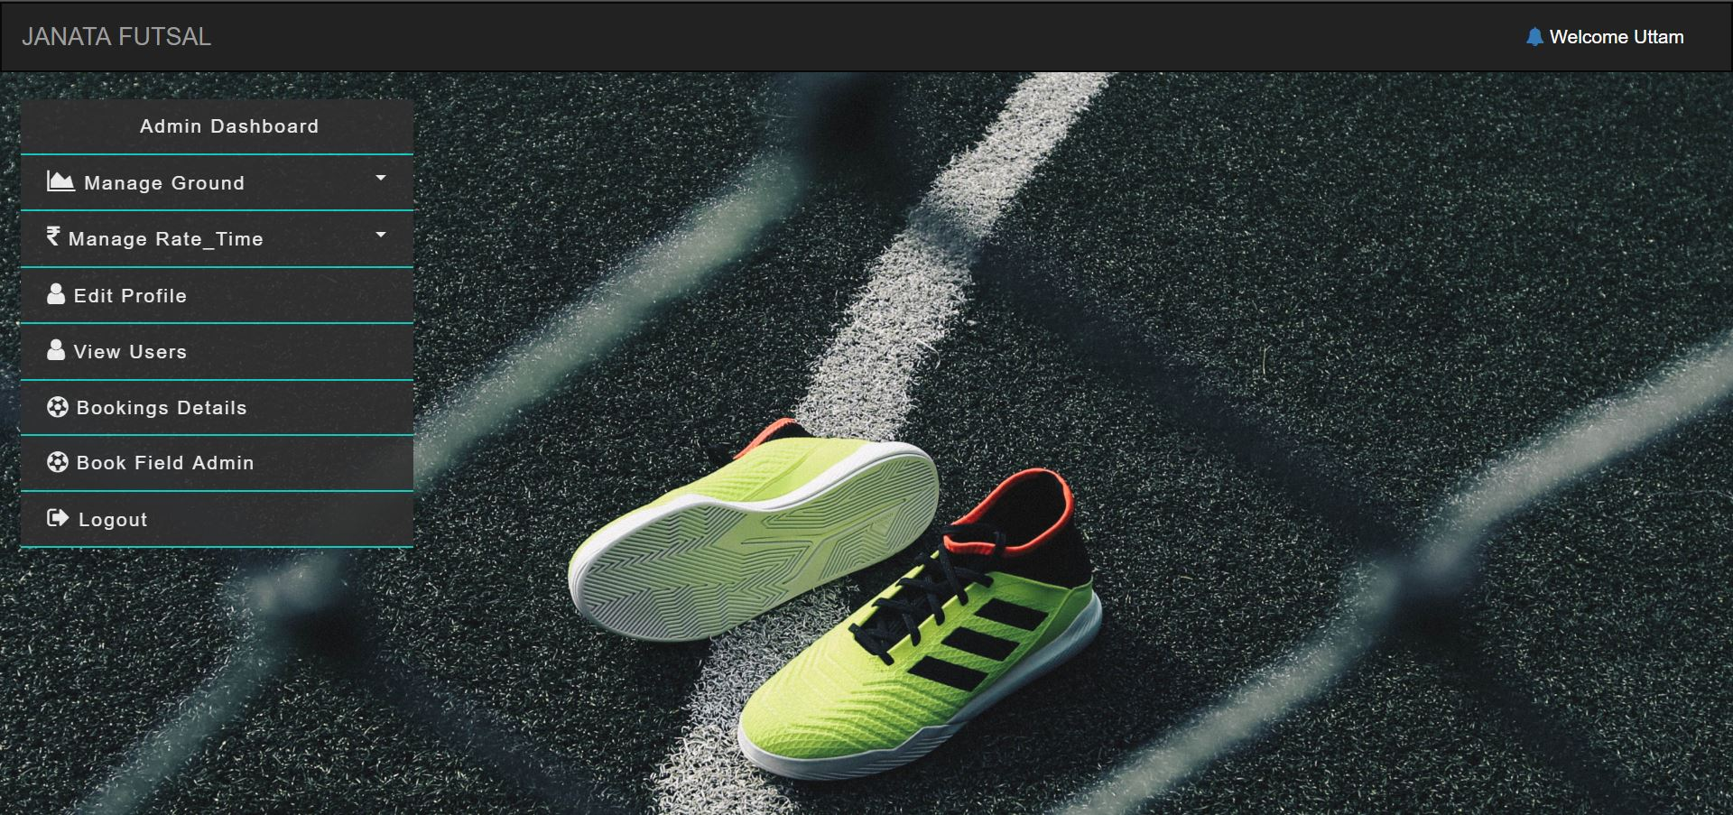
Admin Dashboard

Slide 25
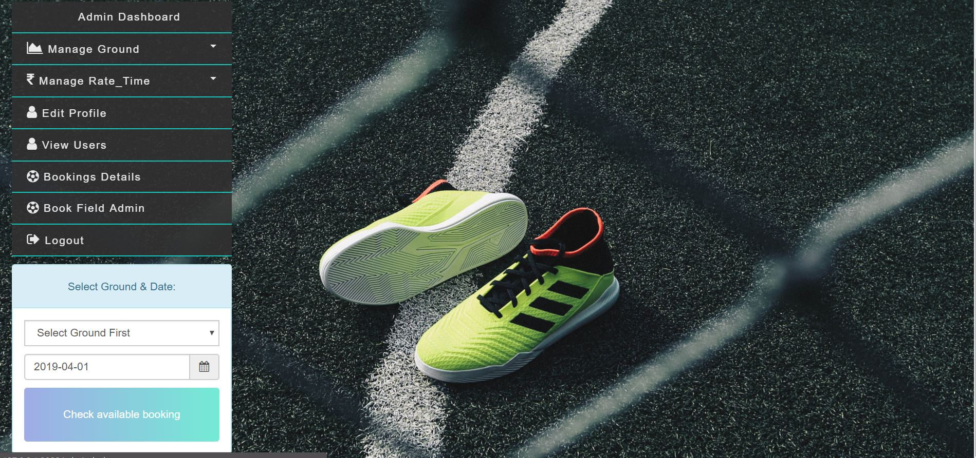
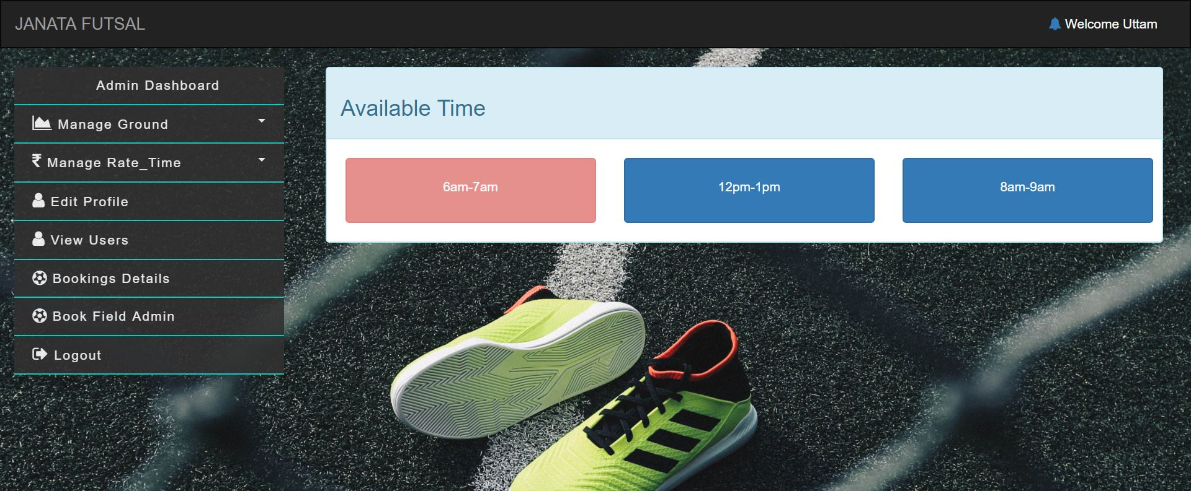
Admin Booking Process

Slide 26
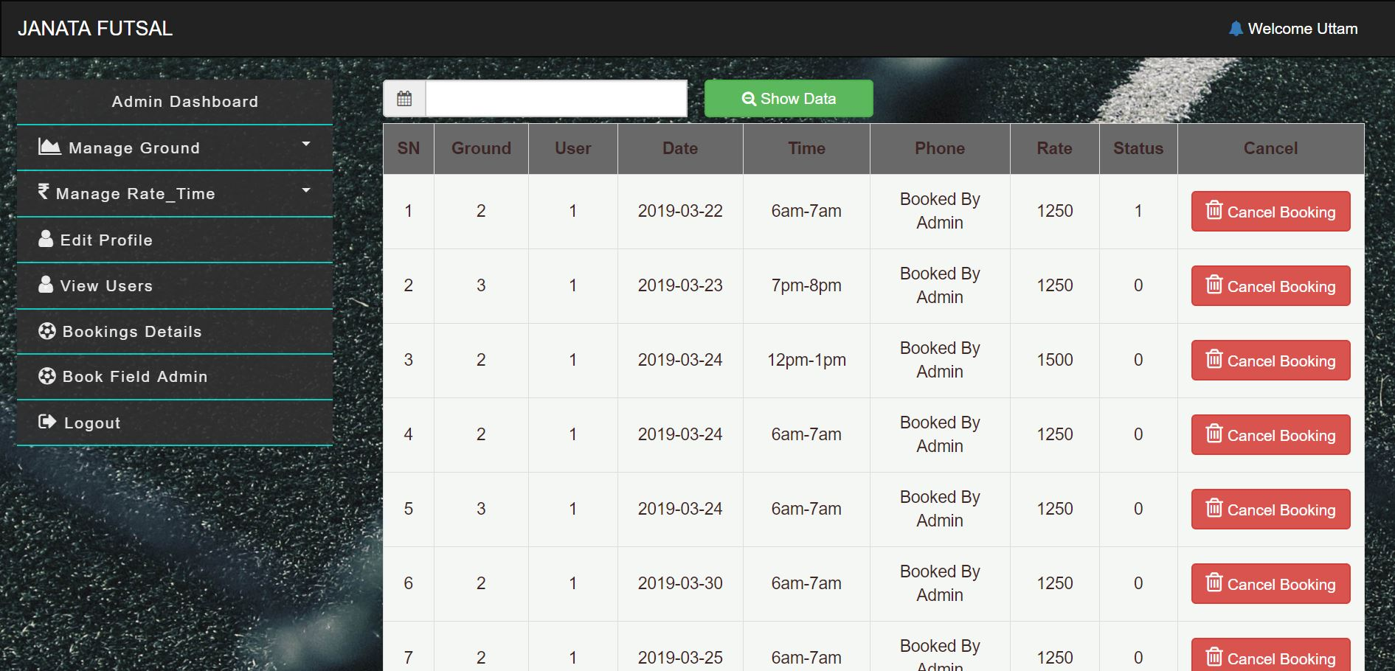
Listing out booking detail for admin.
Initially, Displays All bookings detail
Also, can be sorted with specific time.

Slide 27
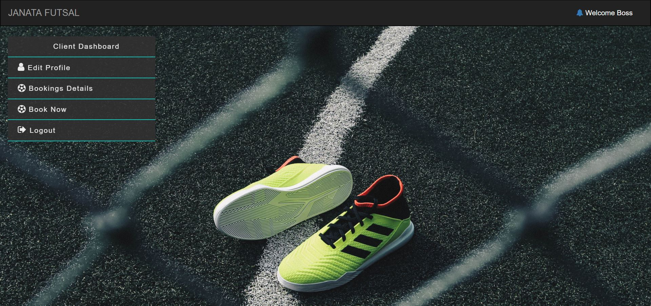
Client Dashboard

Slide 28
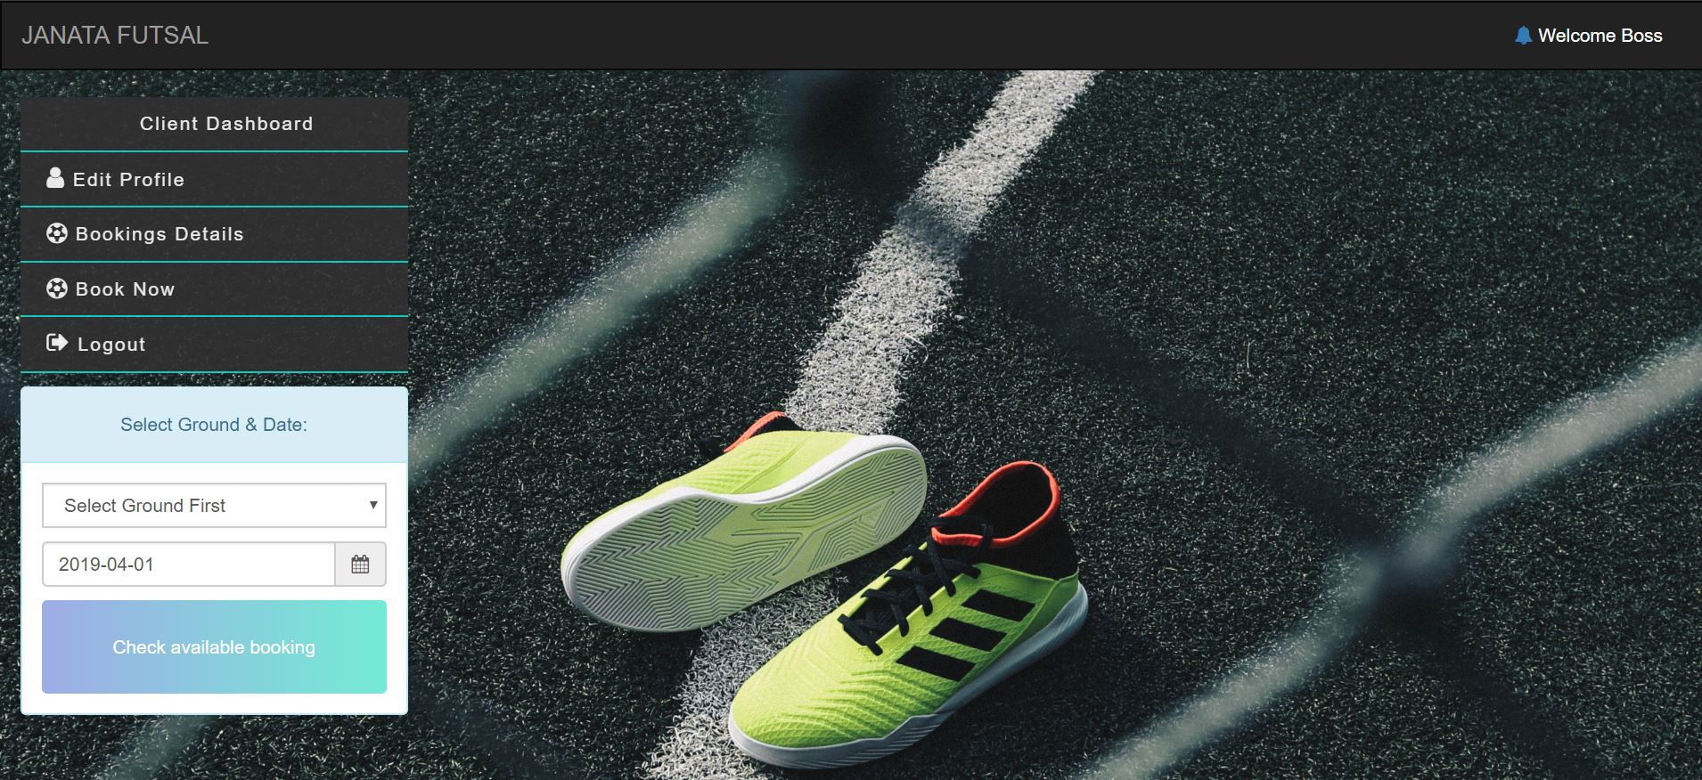
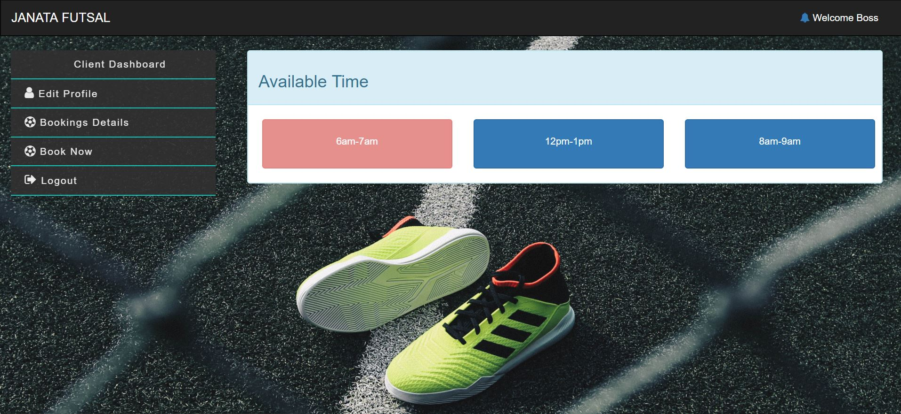
Client Booking

Slide 29
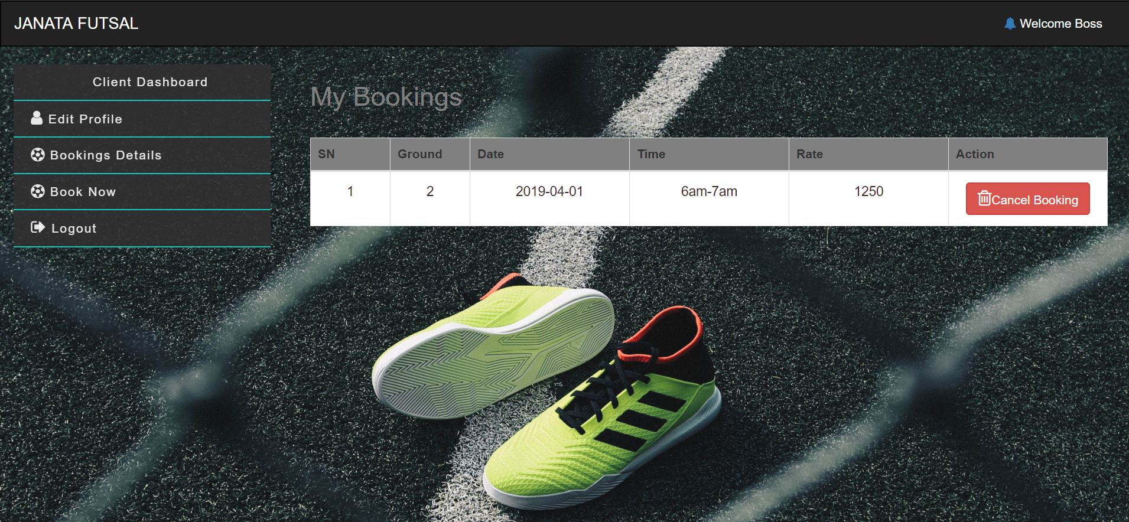
Booking Detail for Client

Slide 30
Testing

Slide 31
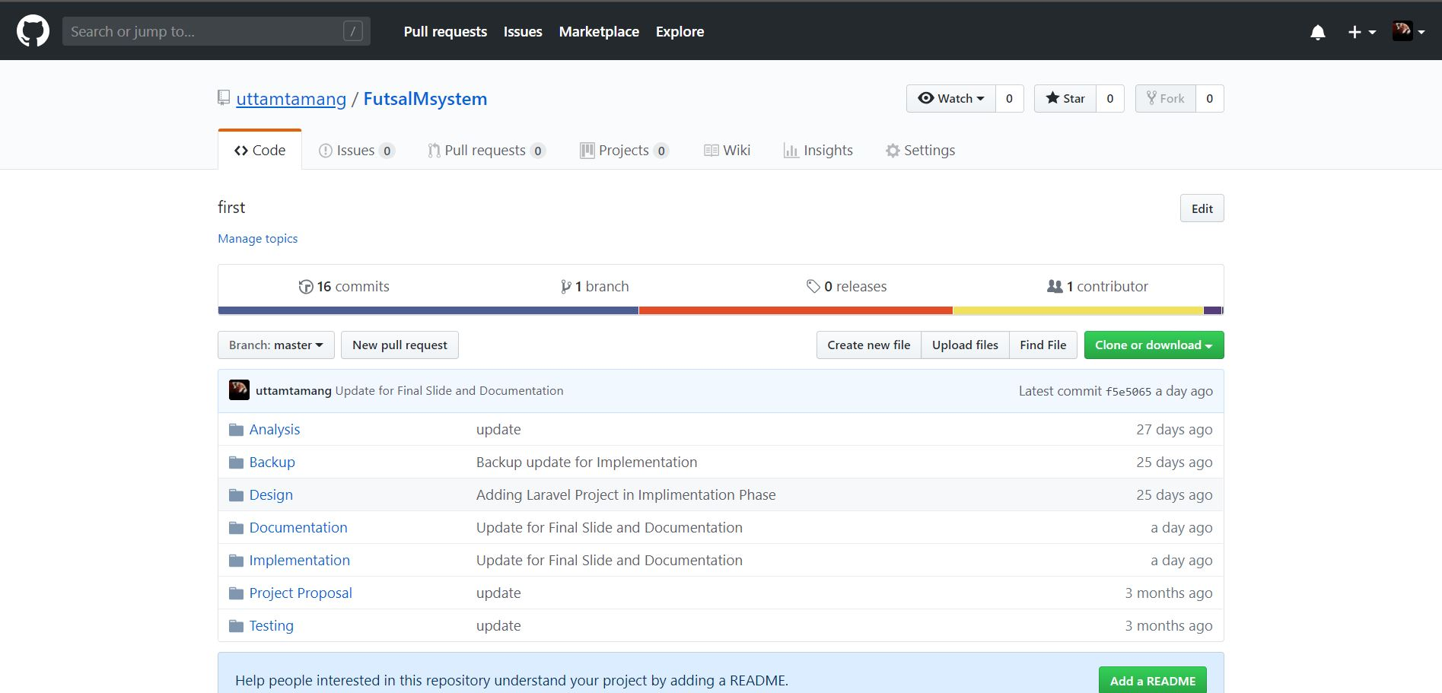
Risk and Configuration Management

Slide 32
Future Work
Online Payment System
Automation in canceling booking which are not paid in time
Accessibility function
UI/UX enhancements
Online Billing/Originality Testing Feature
Customer Helpline system

Slide 33
User Manual

Slide 34
Conclusions
Project that I had completed will help with booking automation for futsal organization in a secure and reliable way.

Slide 35
Any Question?

Slide 36
Thank You

